Slide 1
2023 Legislative Session
Recap
May 30, 2023
Notes:
Good afternoon everyone and welcome to today’s webinar: a recap of Florida’s 2023 Legislative Session

Slide 2
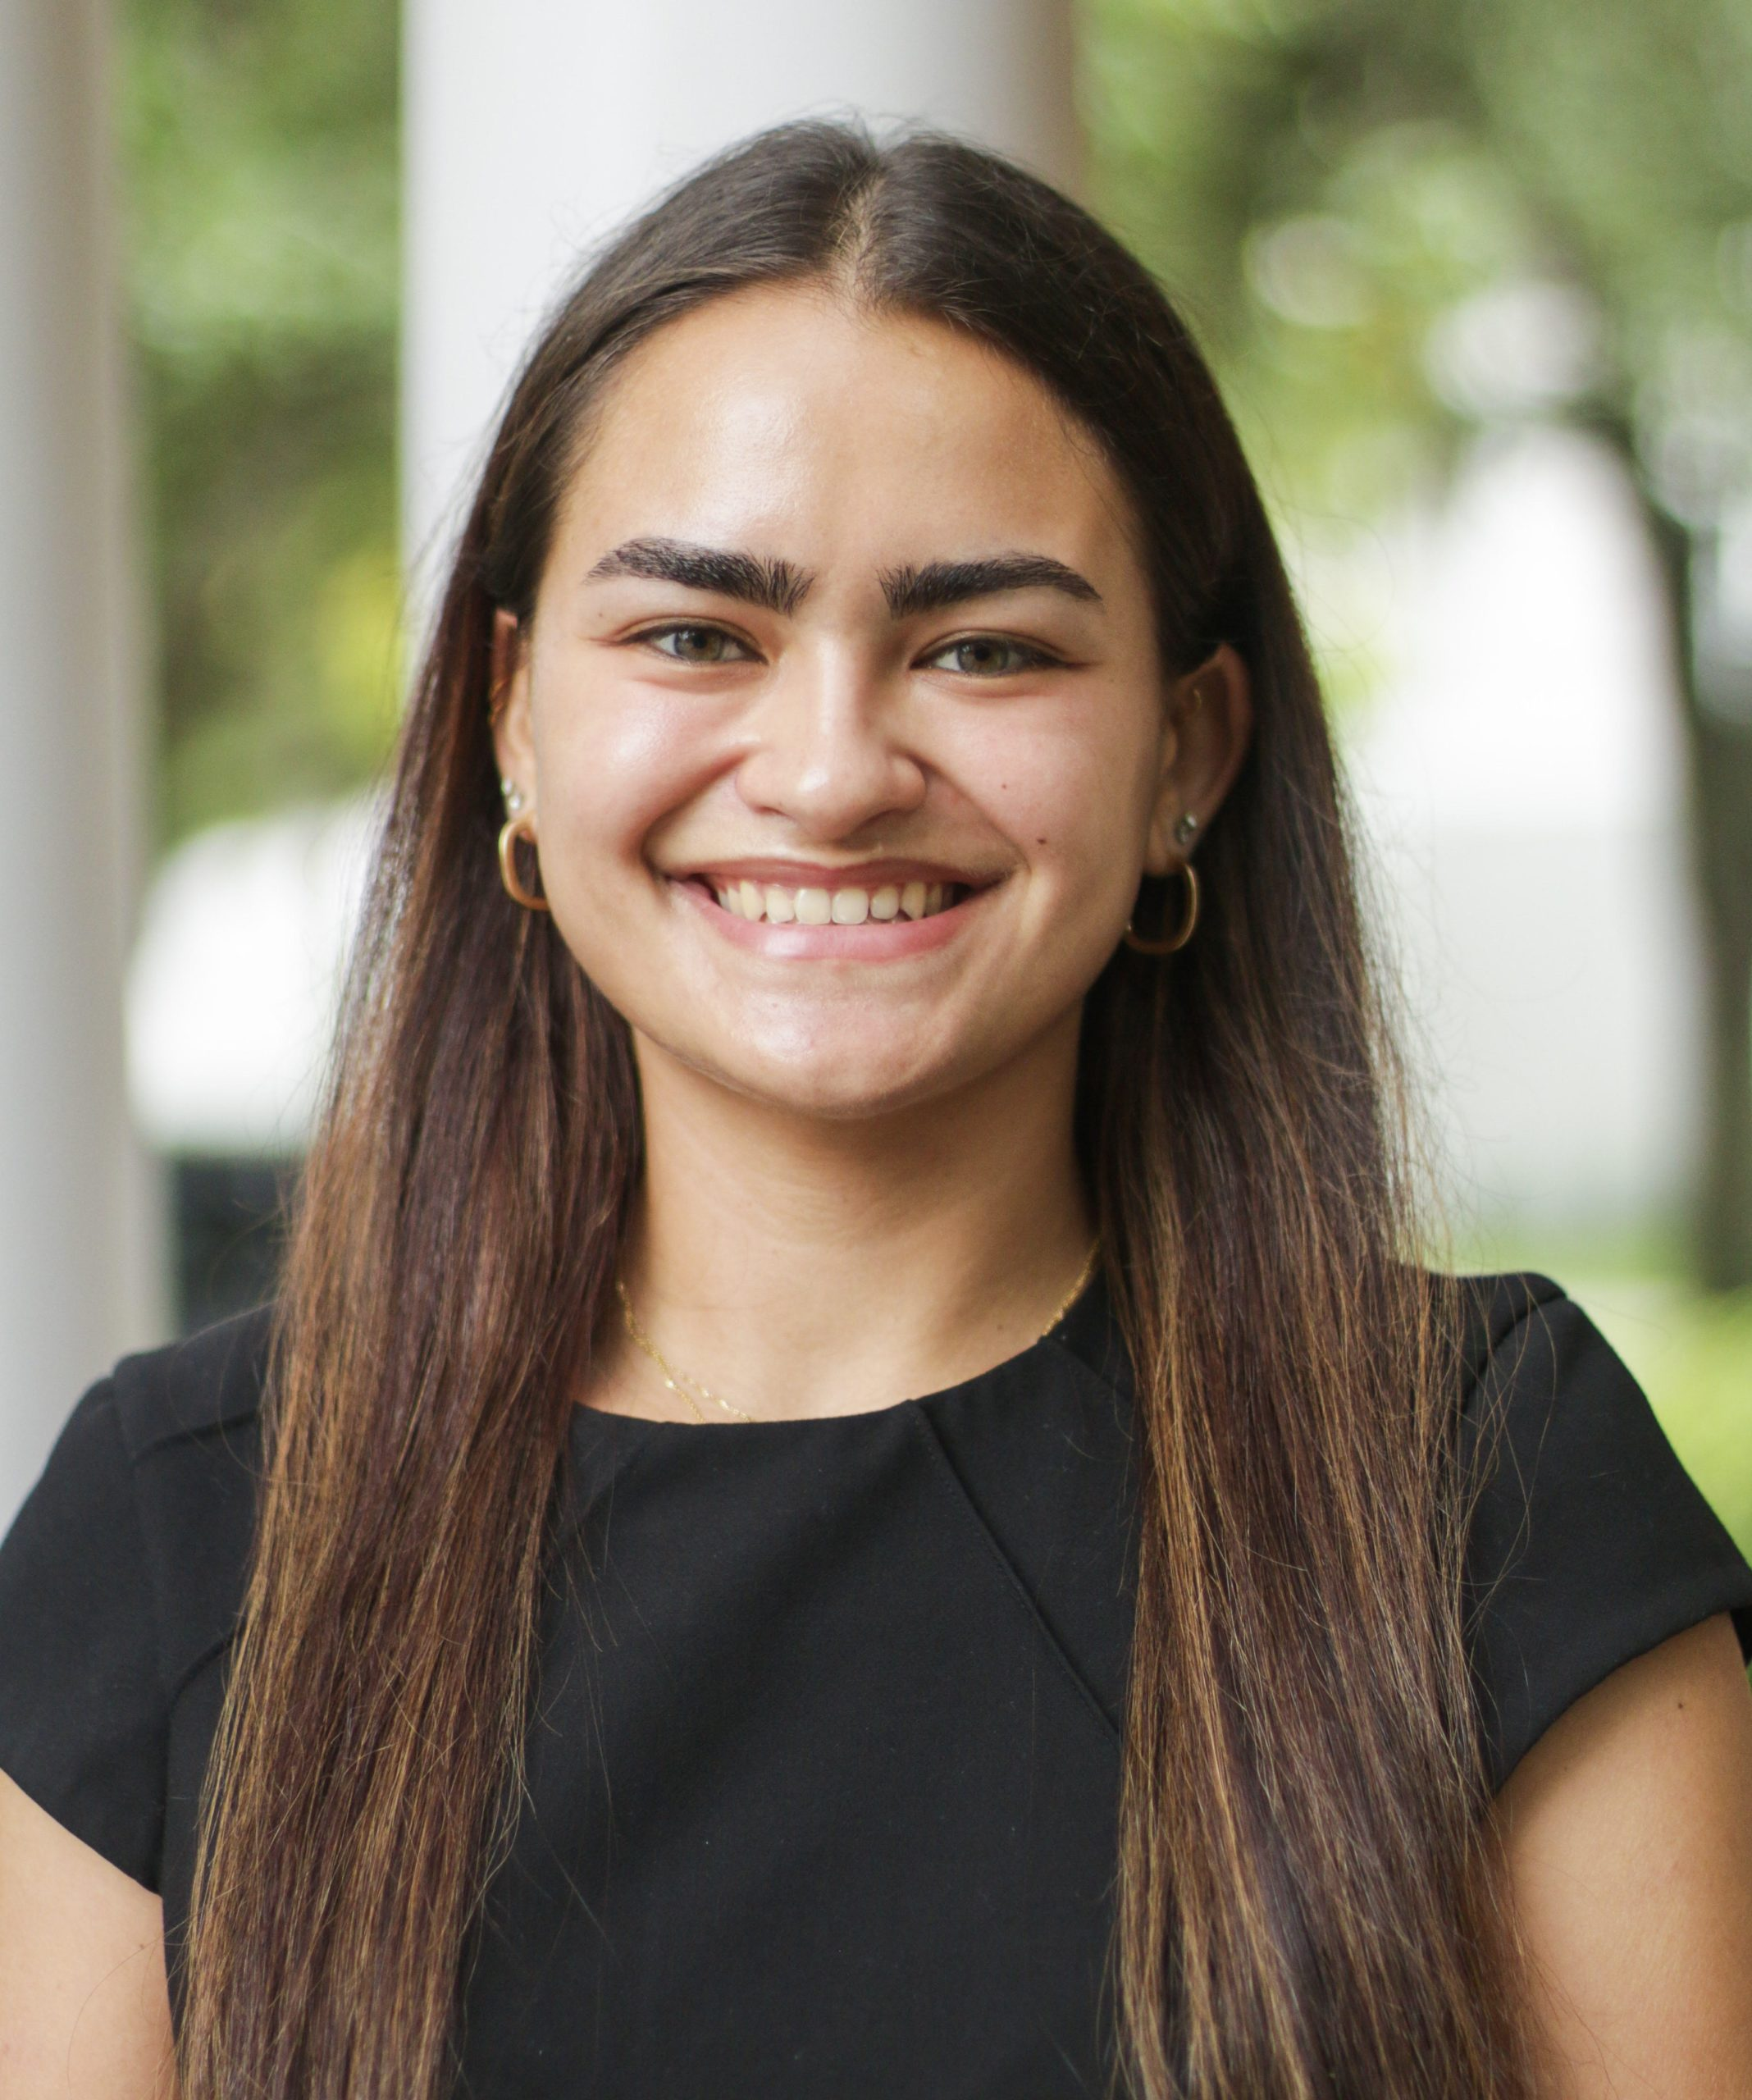
Welcome!
Deborah Martin
Policy Analyst
Florida College Access Network
dmartin@floridacollegeaccess.org
Notes:
My name is Deborah Martin and I’m FCAN’s policy analyst. I’ll be your host today. I am so pleased to welcome today’s presenters, both members of the Florida Legislature, as we have an informative discussion about the 2023 legislative session. We’ll cover highlights of the higher education budget, as well as some new pieces of legislation that will impact students in Florida.

Slide 3

Questions & Conversation
Submit your questions in the box
Share on social media
  Twitter: @FLCollegeAccess
  #FCAN
  #TalentStrongFL
  This webinar is being recorded; all materials will be available within a week of recording
Notes:
Before we get started with today’s presentation, I’d just like to go over a few housekeeping items:
First, we welcome your questions. This is all about learning together so please submit your questions through your dashboard. You can submit them at any time during this webinar and I encourage you to do so as we go through these conversations. Then we’ll answer them towards the end of the presentation.
Second, please share what you are learning on your favorite social media site. We love to hear what’s resonating with you.
Finally, this webinar is being recorded. All materials will be available within a week of the recording.

Slide 4
Our mission:
We lead the collaborative movement to ensure every Floridian achieves an education beyond high school and a rewarding career.
Our vision:
A Florida working together, where education is the pathway to economic mobility for all.
Notes:
I know we have quite a few listeners today who may be new to FCAN’s work.
To give you a little background on who we are, FCAN’s mission is to lead the collaborative movement to ensure every Floridian achieves an education beyond high school and a rewarding career.
Our vision is to see a Florida working together, where education is the pathway to economic mobility for all.

Slide 5
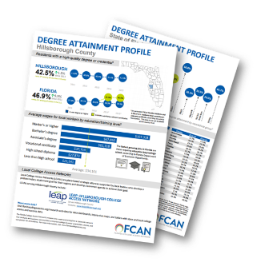
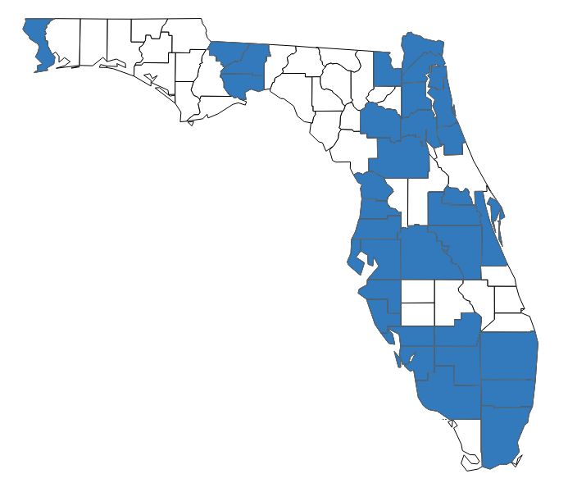

FCAN’s Work
Research and Data FCAN publishes research and data on evidence-based practices and policy opportunities to strengthen Florida's talent pool.
Local college access networks (LCANs) LCANs support 83% of the state’s population. These organizations are made up of community leaders who come together to create solutions and partnerships to support local talent development.
Statewide Initiatives FCAN coordinates 4 College Ready Florida initiatives that provides schools and community organizations resources to help students continue their education after high school.
Notes:
We do our work in 3 central ways – through research and data, shining a light on promising practices at the local and state level through our LCANs, and through 4 statewide initiatives that provide schools and community organizations with free resources to help students continue their education after high school.

Slide 6
7 Conditions for Success
Opportunity for everyone: To build a talent-strong economy, all Floridians need access to a postsecondary education and the supports to complete it.
Clear information and guidance: Students and families need exposure and counseling early and often to make informed decisions about their futures.
Affordability: Postsecondary education needs to be within everyone’s financial reach, regardless of household income or life circumstances.
Multiple pathways to success: Floridians benefit from multiple learning opportunities for academic achievement and career advancement.
Lifelong learning: No degree or credential is “one and done;’ Floridians need to prepare for career changes through continuous learning.
Effective use of data: Transparent access to data on education and economic outcomes, especially for Florida’s diverse populations, helps achieve our goals.
Community collaboration: When community partners work together toward a shared vision, they remove barriers, build a robust workforce, and improve the quality of life for their regions.
Notes:
FCAN’s work is guided by our 7 conditions for success, which are listed here and you can find out more about on our website.
Today’s webinar provides great examples of many of these conditions, particularly:
Opportunity for everyone
Affordability
And community collaboration

Slide 7
Florida’s 2023 Legislative Session
Notes:
So to get started, I’d like to quickly go over some details regarding Florida’s legislative session. The legislature convenes for 60 days every year. This year they started on Tuesday, March 7th and adjourned on Friday, May 5th. Lawmakers passed a historic $117 billion budget and a total of 356 bills. Major policy changes include the expansion of career and technical education, new funding programs to address Florida’s teacher shortage, and legislation to assist military students and families on their postsecondary educational journey. I’d like to point out that unless otherwise indicated all the bills discussed today, along with the budget, are waiting for the Governor’s signature. Today, we’ll discuss some of these exciting bills with our special guests.
Now, I’ll introduce our speakers for today. Two members of the Florida House -- first, we have Rep. Kristen Arrington, currently representing district 46, as part of Osceola county. Rep. Arrington has been serving in the legislature since her election in 2020. And we also have with us, Rep. Lindsay Cross, elected in 2022, representing district 60 in Pinellas county.

Slide 8
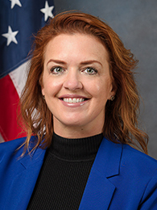
Representative Kristen Arrington
(D46 – Kissimmee)
SB 196: Guidance Services on Academic and Career Planning
  This bill takes effect on July 1st
  Signed by the Gov. on May 17th
Notes:
Good afternoon Rep. Arrington and thank you for joining us today to discuss SB 196: Guidance Services on Academic and Career Planning
Before we get into the context of the bill -- can you tell us a little bit about your district – is it urban/suburban/rural, what are the demographics, major businesses or employers?
Can you tell us what the bill does and the impact it will have on college and career planning for high school students?
This bill seeks to provide additional information to students and their families. What led you to file this bill? How were you able to convince your colleagues in the legislature that this was a worthwhile investment?
Thank you so much Rep. Arrington, it will be exciting to see how this will better prepare students for the choices they’ll make after high school.
Now we’ll move to our next speaker--

Slide 9
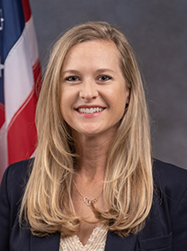
Representative Lindsay Cross
(D60 – St. Petersburg)
SB 1190: Step into Success Workforce Education and Internship Pilot Program
  This bill takes effect on July 1st
SB 274: Nursing Education Pathway for Military Combat Medics
  This bill takes effect upon becoming a law
Notes:
Good afternoon Rep. Cross, thank you for joining us today to discuss two bills– SB 1190 and SB 274. Before we get into the context of the bills -- can you also talk a little bit about your district – is it urban/suburban/rural, what are the demographics, major businesses or employers?
Can you describe the provisions in both bills listed?
As we think about how to expand postsecondary educational access to “non-traditional” student populations, can you talk about the impact these bills will have for their respective communities? (foster youth and military veterans)
Thank you Representative Cross. These bills are both full of innovative policy changes that will help these two populations be successful in our postsecondary system. Now, we’ll move into a brief discussion about an additional policy changes and some budget highlights.

Slide 10
CS/CS/SB 240: Education
Sponsor: Senator Travis Hutson (R – St. Augustine)
Expanding components of 2021 REACH Act
Experiential Learning Tax Credit Program
Workforce Education Partnership Programs
CTE Expansion and Work-based Learning
Other Provisions
  Career Planning
  Workforce Board Alignment
  Open Door Grant Program
Effective Date: Signed on May 17th, effective on July 1st
Notes:
In some parts, this is an expansion of the REACH Act from 2021, major CTE expansion across various areas of K-12 system
Ensuring collaboration and facilitation across DEO, DOE, and CareerSource to develop and expand apprenticeship, pre-apprenticeship and other work-based learning opportunities for Floridians
Expanding the work of the credentials review committee to ensure that industry certifications for agricultural occupations are submitted for consideration onto the MCL
Experiential Learning Tax Credit Program
Expands the current internship tax credit program to include other on the job learning opportunities like apprenticeships and pre-apprenticeships. Businesses would be eligible ($2,000 per individual) if the intern completes 9 consecutive weeks of work and/or if the apprentice worked at least 500 hours.
Registered apprenticeships are paid in FL
Workforce Education Partnership Programs
SUS may set up a workforce education partnership to provide assistance to their students employed with a private business, who wish to participate in this program.
Participating students would be eligible to receive mentorship services, a housing stipend, and life management and professional skills training.
As well as tuition assistance, assistance from the SUS to ensure they are receiving all the financial aid they are eligible for
CTE Expansion and Work-based Learning
Each school district is responsible for ensuring that each student in grades 9-12 has access to one work-based learning opportunity.
Students may take one course in CTE to satisfy their requirement for a credit in fine or performing arts needed for a standard high school diploma.
Provides an opportunity for middle school students to continue their CTE coursework in a connected program in a district high school.
Or if they received a certification included on CAPE Funding List
SBE must adopt rule to allow students to receive work-based learning credit for participation with CTE student organizations.
Such as Future Farmers of America or FFA
Other Provisions
Beginning with the 23-24 school year, each high school must hold an annual career fair – and ensure juniors and seniors have the opportunity to meet and interview with prospective employers.
Group of HS in a district may hold a career fair at an alternative location to satisfy this requirement – must be located within reasonable driving distance of all participating schools.
Must be held during the school day
SBE will adopt rules to allow district career centers to offer associate in science and associate in applied science degrees.
Provided in order to meet workforce standards, the district career centers must establish agreements with the local FCS institution/s
Each local workforce development board is responsible for creating an education and industry consortium to provide community-based information to assist the board in making decisions for program and service delivery in their respective community.
Updates to the Open-Door Grant Program
Students enrolled in an eligible workforce education program will have 100% of their tuition and fees paid for (after all applicable federal and state aid is applied). Students will receive additional $1,500 stipend for other costs related to cost of attendance – such as housing or transportation.
Provides funds to support student completion of short-term, high-demand credit and non-credit CTE programs
Updated now to just any CTE program that leads to a credential, certificate or a degree.
Effective date: July 1st – signed by Gov. on May 15th

Slide 11
CS/SB 1272: Educational Grants
Sponsor: Senator Corey Simon (R – Tallahassee)
Expansion of the EASE Program for students attending private colleges and universities
  Effective Access to Student Education
Effective Date: effective upon becoming a law, signed on May 17th
Notes:
Bill expands the EASE (Effective Access to Student Education) grant to institutions that were eligible for the former ABLE (Access to Better Learning) grant
If university has been established for more than 20 years, offers nursing programs, and is accredited by the Higher Learning Commission
Students attending an independent for-profit university or college that has a level 6 accreditation from the Commission on Colleges of the Southern Association of Colleges and Schools
Schools that benefit include: Herzing University, South College
Effective date: Upon becoming a law, signed on May 17th

Slide 12
CS/HB 1035: K-12 Teachers
Sponsor: Representative Gonzalez-Pittman (R – Tampa)
Fee waivers for state-approved teacher preparation programs
Creates:
  Dual Enrollment Educator Scholarship Program
  Teacher Apprenticeship Program and Mentor Bonus
  Heroes in the Classroom Bonus Program
Effective Date: Signed on May 9th, effective on July 1st
Notes:
Tuition and fees waived for those enrolled in a state-approved teacher preparation program
Dual Enrollment Educator Scholarship Program
Would pay for the graduate degree/credentials needed to teach dual enrollment courses
Covers full cost of tuition and fees, including a book stipend for each semester
Individuals must complete program within 3 years of receiving award, teach at least one DE course a semester, and remain in their school district for at least 3 years after degree completion.
Teacher Apprenticeship Program and Mentor Bonus
Alternative pathway into teaching profession
Apprentice teacher must complete two years as an apprentice before applying for professional teaching certificate. Serve under a mentor
Would be paid – classified as an education paraprofessional
Mentor Bonus
Subject to GAA, teachers who have at least 7 years of experience in FL and have a “highly effective” rating would be eligible for a bonus for serving as a mentor for a teacher apprentice.
2,000 mentor teachers, first come first serve basis
$4,000 bonus total – split in two payments
Heroes in the Classroom Bonus Program
One-time, sign-on bonus for retired first responders and veterans who become teachers. Additional bonus may be available if they teach a course in a critical shortage area.
DOE responsible for identifying what these critical shortage areas are
SBE will adopt rules for the administration of these new programs
Effective date: July 1st – signed by Gov. on May 9th

Slide 13
Budget Highlights
Record breaking $117B budget, the largest in state history
State University System: $3.68 billion
  $645 million for state university performance-based funding incentives
  $38.5 million for incentives for Programs of Strategic Emphasis
  $100 million for preeminent state research universities
  No tuition increases
Florida College System: $1.59 billion
  $20 million for students earning industry certifications
  $30 million for student success incentive funds
  No tuition increases
Financial aid programs
  EASE: $134.8 million, for 37,728 students
  Bright Futures: $590.6 million
  FSAG: $387 million
  Open Door Grant Program: $35 million
Workforce Education: $650 million
  $20 million for the Pathways to Career Opportunities Grant Program
  $5 million for the new Adult General Education Performance-based Incentive Funds
  $4 million for the new Teacher Apprenticeship Program and Mentor Bonus
Other notable items
  $32 million for HBCUs
  $125 million for nursing education (PIPELINE & LINE)
Notes:
As mentioned at the beginning of this webinar, the legislature passed a record breaking $117 billion budget – surpassing what was last year’s record of the largest in state history.
Funding for major education pots are detailed but some important parts to note are the state university system received $3.68 billion, Florida college system received $1.59 billion, and workforce education initiatives were funded at $650 million. We see that this is yet another year where we do not have any tuition increases – a continued effort in the Legislature to in keep our higher education system affordable.
Financial aid programs were vastly funded with some major ones listed on the screen. EASE received $134.8 million which will provide funding for almost 38,000 students across our state. Bright futures was funded at $590.6 million and FSAG, or the Florida Student Assistance Grant, which is Florida’s need-based aid program, received $387 million.
Lastly, there is $32 million for Florida’s HBCUs. We also see the PIPELINE and LINE Funds, new programs created during the 2022 leg. session to address Florida’s nursing workforce shortage. These programs are funded again at $125 million.

Slide 14
Questions?
Notes:
*Invite the speakers to turn on their cameras.*
And now we’ll now open it up to questions from the audience.
Great, thank you everyone for submitting your questions. I would encourage you to reach out if we didn’t get you or if you thought of another one after we conclude.
Rep. Arrington – Senate bill 196 was passed unanimously. Why do you think this proposal gained bipartisan support?
Rep. Cross – SB 1190 is a great example of a bill that brings together multiple agencies and sectors. Can you talk about the importance of collaboration among multiple stakeholders?
Both – Building a budget during a period of financial restraint can be difficult, as the legislature tries to prioritize funding across multiple sectors while taking cuts into consideration. On the other hand, can you discuss what it might be like to contribute to and work on a budget during a surplus?
Both – Florida hasn’t raised tuition costs since 2013. How has the legislature been able to prioritize college affordability consistently when, as we know, we live in a diverse state with various competing issues and needs?
Both – How can our local college access networks, listening on this call, continue to work towards being good advocates for these policies?
Both – We have some really exciting bills passed that will begin implementation this year. We know it’s early, but can you potentially share some priority areas for yourselves/next year’s session?

Slide 15
Conclusion
Notes:
Well, I’d like to thank Rep. Arrington and Rep. Cross for joining us today as we learned more about new legislation that stands to impact Florida’s students and for their tireless efforts to expand educational opportunities in Florida.
This is the end of our webinar and thank you for joining us today!

